Slide 1

Presentation about the organization structure for ExxonMobil
Youmna Mahmoud, Tommy Baronner & Rushabh Barbhaya
9/15/2018

Slide 2
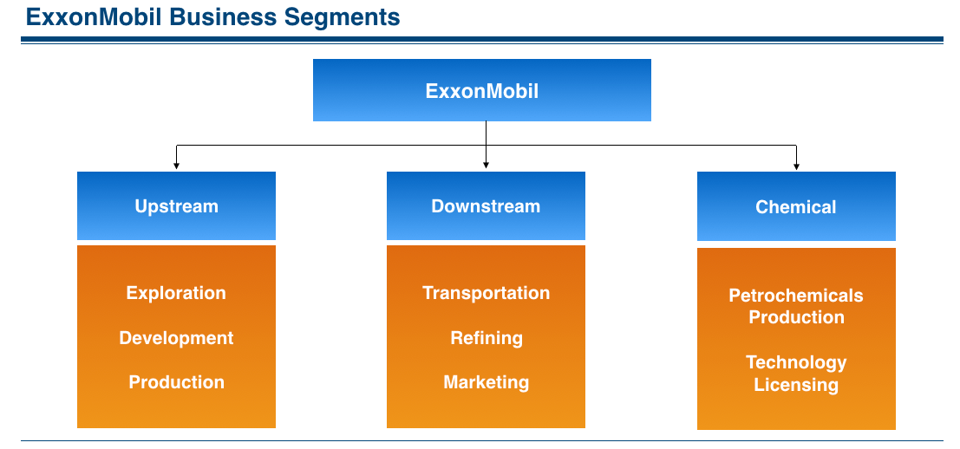

Slide 3
Our thoughts
Core Products
Which structure?
Reason for this structure? i.e. communication, management

Slide 4
Is this appropriate?
This structure works perfectly fine. This company is in its sustenance period (est. 1882).

Slide 5
Youmna Mahmoud, Tommy Baronner & Rushabh Barbhaya

